Slide 1


Managing risk in the supply chain

Slide 2
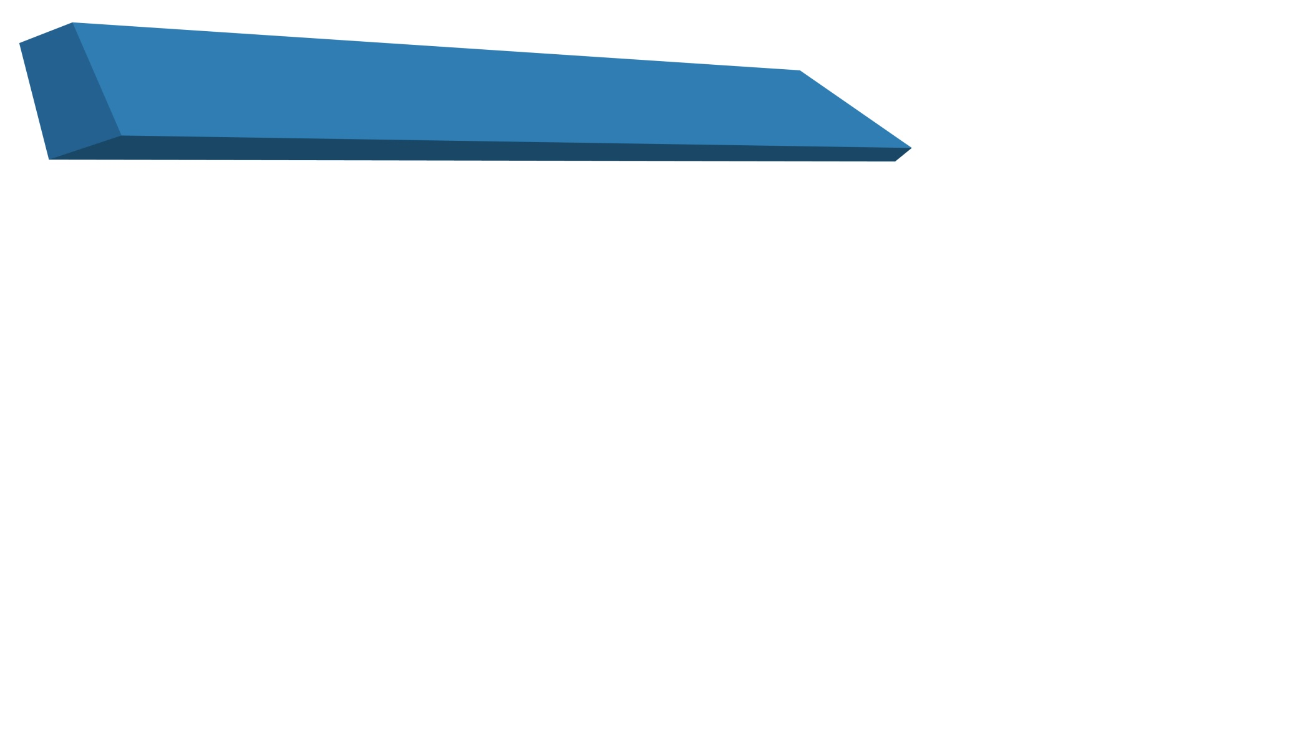

Main Title Goes Here….
Chapter Topics | CLO Alignment (C4)
Why are supply chains more vulnerable? | Analyze sources and drivers of supply chain risk
Understanding the supply chain risk profile | Examine and assess risk exposure across supply chain stages
Managing supply chain risk | Analyze mitigation strategies and trade-offs
Achieving supply chain resilience | Evaluate resilience strategies with sustainability focus
www.umt.edu.pk

Slide 3
Supply Chain Risk
Market Turbulence and Uncertainty
  Demand volatility higher than in the past
  Difficulty in forecasting life-cycle demand
  Frequent competitive product launches
  Rapid technological changes
Sources of Supply Chain Chaos
  Sales promotions and discount campaigns
  Quarterly sales incentives
  Reorder quantity rules and batch ordering
  Information distortion across the chain
Rising Supply Chain Vulnerability
Supply chains are increasingly exposed due to:
  Natural disasters
  Strikes and labor disputes
  Terrorist attacks
  Epidemics and pandemics
  Sudden changes in business strategy

Slide 4
Impact of Business Model Changes
Changes that increase supply chain risk:
  Adoption of lean and JIT practices
  Increased outsourcing
  Reduction in the supplier base
  Global sourcing strategies
Financial Impact of Supply Chain Disruptions
  Research evidence (North America):
  Operating income ↓ 107%
  Return on sales ↓ 114%
  Return on assets ↓ 93%

Slide 5
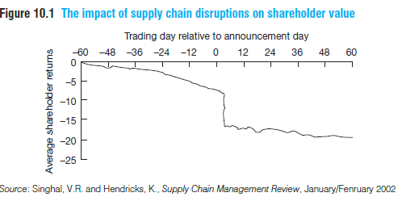
Impact on Shareholder Value (Figure 10.1)
  Significant decline in shareholder returns following disruption events
  Market reacts quickly once disruption becomes public
Managerial Gaps in Risk Management
  McKinsey survey (3,000+ executives):
  Majority perceive growing supply chain risk
  Many firms lack formal risk mitigation processes
  Risk assessments focus on:
  Financial risk
  Regulatory risk
  Supply chain risk often ignored
Types of Supply Chain Risks
  External Risks
  Natural disasters
  Wars and terrorism
  Epidemics
  Government regulations
  Internal Risks (Manageable)
  Supply chain design
  Sourcing strategy
  Inventory policies
  Relationship management

Slide 6
Why are supply chains more vulnerable?
Definition of Supply Chain Vulnerability (Cranfield University definition):
“An exposure to serious disturbance, arising from risks within the supply chain as well as risks external to the supply chain.”
Why Are Supply Chains More Vulnerable?
  Key contributing factors:
  Focus on efficiency over effectiveness
  Globalisation of supply chains
  Focused factories and centralised distribution
  Outsourcing trends
  Reduction of supplier base
Focus on Efficiency vs Effectiveness
  Strong emphasis on:
    Cost reduction
    Inventory minimization
Widespread adoption of JIT and lean systems
High dependence on suppliers

Slide 7
Globalisation of Supply Chains
  Shift from “local for local” to global sourcing
  Components and assembly spread across continents
  Driven mainly by cost reduction
Risk Implications:
  Longer lead times
  Higher buffer inventory
  Greater obsolescence risk
Hidden Costs of Global Supply Chains (Total supply chain cost ≠ purchase cost)
  Often ignored costs:
  Extended transportation risk
  Supply disruption exposure
  Demand mismatch
  Environmental impact

Slide 8
Focused Factories and Centralisation
  Fewer manufacturing sites
  Large-scale production
  Centralised distribution centres
  Benefits:
  Economies of scale
  Lower unit costs
  Risks:
  Loss of flexibility
  Increased disruption impact
Reduction of Supplier Base
  Shift to fewer suppliers
  Single sourcing strategies (Failure of one supplier can halt operations, Like chip disruption)
  Benefits:
    Stronger relationships
    Lower transaction costs

